Slide 1
Device Assignment in Arm CCA
Derek D. Miller
4 September 2024

Slide 2
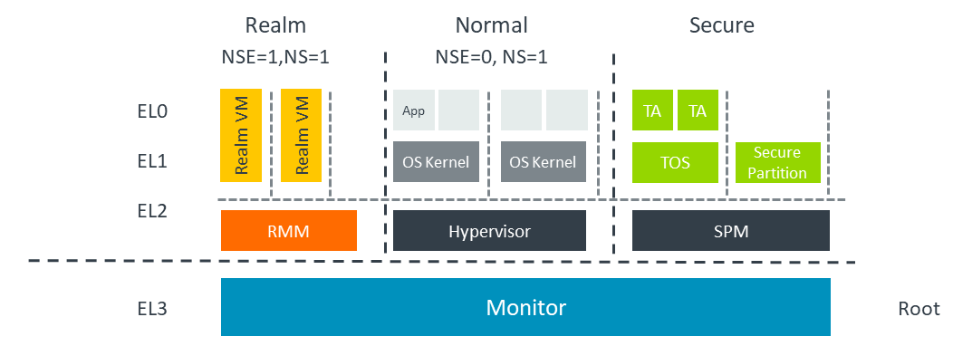
Introduction to Arm CCA
Arm Confidential Compute Architecture (CCA) is designed to protect data and code in use by creating isolated execution environments called Realms.
Key Features:
Full software stack Isolation from the host OS and hypervisor
Hardware-based security mechanisms
Blind hypervisor – Realm can contain a full OS stack
Support for attestation

Slide 3
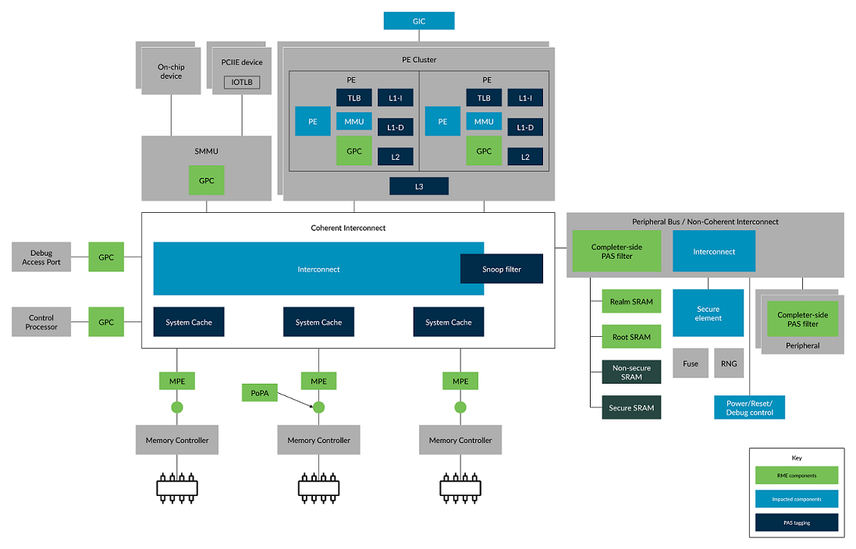
Architecture Components
RME extension in the CPU
MMU
Add GPC
SMMU
Add GPC
MPE – Memory Protection Engine
Provide encryption and optionally integrity
Completer-side PAS Filter on simple on-chip, memory mapped peripherals
Granule Protection Checks (GPC) between peripherals that can independently access memory and the system bus
For some of these, this will be provided by the SMMU

Slide 4
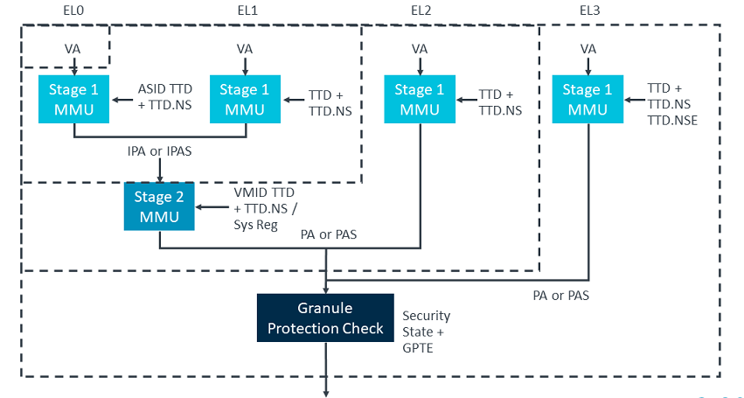
Granule Protection Check

Slide 5
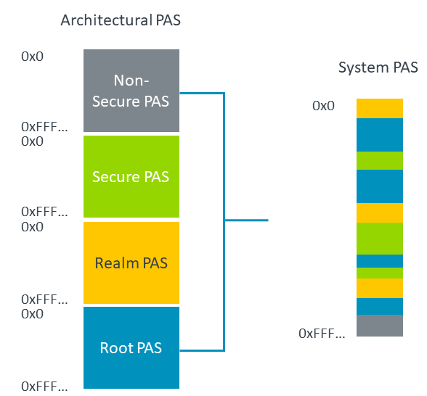
Granule Protection Check
Security state | Non-secure PAS | Secure PAS | Realm PAS | Root PAS
Non-secure | Yes | No | No | No
Secure | Yes | Yes | No | No
Realm | Yes | No | Yes | No
Root | Yes | Yes | Yes | Yes

Slide 6
RMM
Design constraints in the RMM meant we didn’t want it to have specific drivers for multiple devices
DA presents a standard mechanism for attesting all device types
Interrupts are directed to the CVM realm

Slide 7
What is Device Assignment?
Definition: Device assignment allows hardware devices to be securely mapped to Realms, ensuring that only authorized Realms can access assigned devices.
Importance: Allow CCA realms’ Roots of Trust (RoT) to be extended to devices outside of the CPU
Enabling them to use GPUs, ML Accelerators, cryptographic accelerators, even DPUs
Three broad categories of devices
On-SoC peripherals that are not DMA-capable
These do not need device assignment – RMM/VMM managed page tables are sufficient
On-SoC peripherals that are DMA-capable (Root Complex Integrated Endpoints – RCiEP)
Off-SoC peripherals
For devices with multiple interfaces, the realm must trust the device to isolate the device context appropriately

Slide 8
On-SoC peripherals that are not DMA-capable
Attestation is provided via the platform attestation token
Trust in the peripheral is presumed by trust in the platform
But the presence of the device is not explicit
It’s implicit in the platform’s memory map

Slide 9
On-SoC peripherals that are DMA-capable (Root Complex Integrated Endpoints – RCiEP)
Attestation is provided via the platform attestation token
But additional GET_MEASUREMENTS calls may be supported to establish trust in the device firmware
Realm must approve it being added to its root of trust
Each device needs an EL3 driver
The specifics of interface report retrieval is device-specific
Realm can get details on the device through the RSI_RDEV_GET_INFO call
To ensure that non-secure cannot intercede, the device should be placed behind a Realm Physical Address Space filter (by the SoC vendor)
Limit access to Root/Realm security state

Slide 10
Off-SoC peripherals
Device Assignment does apply
physical link must be protected against physical attacks
By IDE or similar
Attestation is provided via TDISP/SPDM
But the realm must approve it being added
After checking the GET_CERTIFICATES and GET_MEASUREMENTS results
Interface between the RMM and device is generic
So the RMM does not need device drivers
This was a requirement to keep the RMM as simple as possible

Slide 11
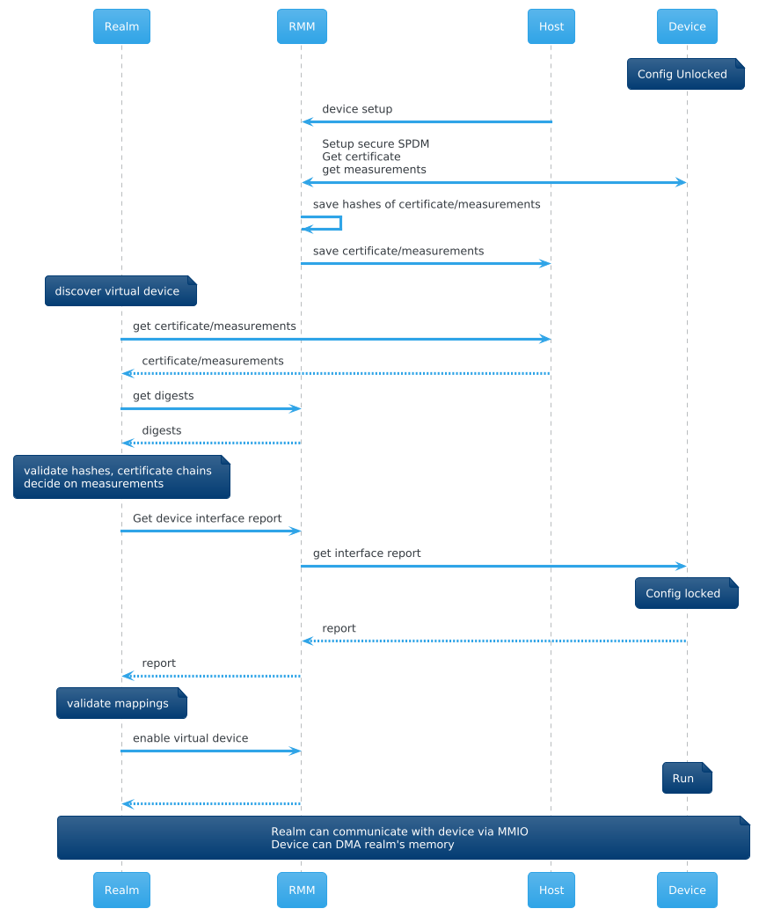
Software Flow
SPDM/IDE session is setup by the RMM before the device is trusted
Necessary to ensure integrity of certificate and measurements
Storage of certificate and measurements is done by the host
To avoid allocations in the RMM
RMM maintains hashes of them
Realm enters the picture relatively late

Slide 12
Attestation challenges
Unification of Attestation “ground truth of trust”
It is desirable to have one entity responsible for determining acceptability of a TCB
Often, this is an external service (such as Veraison) – but essentially, attestation is establishing the suitability of an environment to a relying party
However, RME-DA requires the Realm software to determine if it trusts the device
It can do this autonomously (without going to an external service)
But this separates the “ground truth of trust” between the service and the Realm software – management of this can be error prone (or, more likely, not done)
It can do this by going to the external service
But this adds another round trip to the external service – or the relying party
More work needs to be done here
Inclusion of on-SOC devices in the address map means they ”appear” on the platform attestation token
But this is not as explicit as I’d like

